Slide 1
Westward Expansion
Welcome to the world of watching how the USA went from 13 colonies to 50 states. Sit back and enjoy!

Slide 2
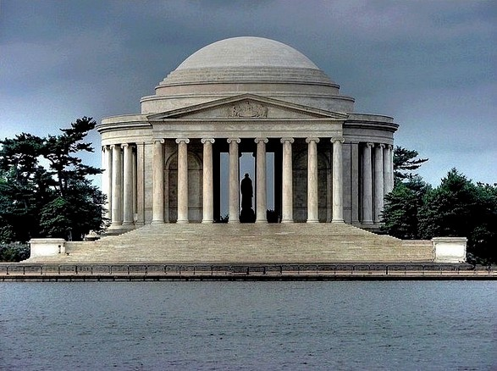
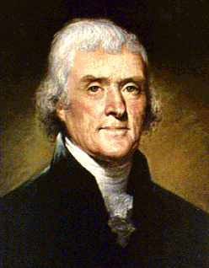
Thomas Jefferson becomes the 3rd president (1800-1808)
What is he famous for?

Slide 3
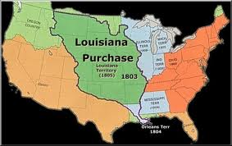
Louisiana Purchase (1803)
For $15 million the USA doubled in land size
Napoleon of France needed the $$ fighting war with GB

Slide 4
Washington, DC (1800)
In 1790, GW said the nation’s capital will move from Philadelphia
John Adams was the 1st president to live in the White House
Benjamin Banneker finished the design of the city

Slide 5
Aerial of Washington, DC

Slide 6
Washington, DC p. 2

Slide 7
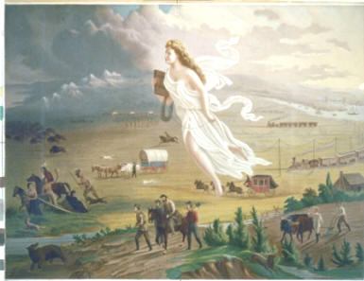
Manifest Destiny
God wants us to expand across the entire continent
Angel Columbia leading the way

Slide 8
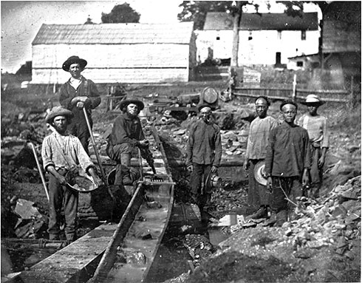
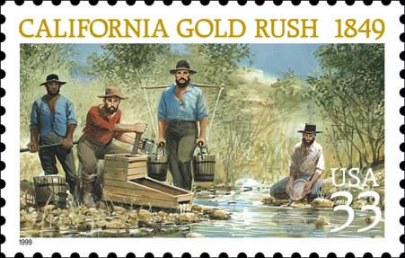
California Gold Rush (1849)
Gold was found in 1848, so many pioneers headed westward in 1849 (called the 49ers)

Slide 9
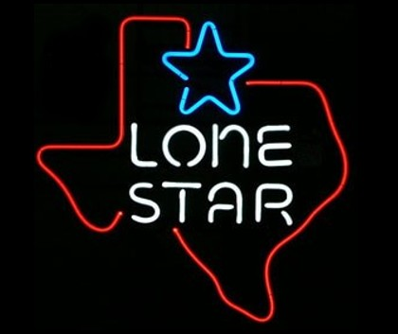
Texas
Mexico got its independence from Spain in 1821
Encouraged Americans to live in Texas (part of Mexico)
Rules to follow: No slavery was allowed; Americans must learn Spanish; Americans not happy in TX mad; fight will be on

Slide 10
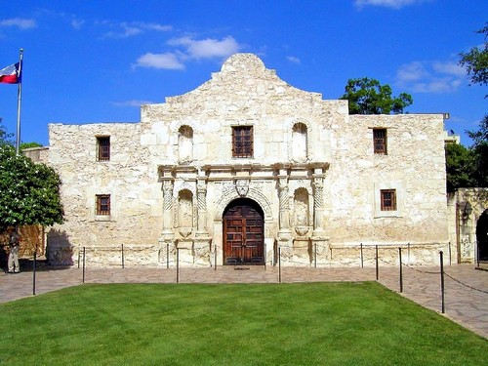
“Remember the Alamo!”
Mexicans kill about 180 Americans at the Alamo
Americans in Texas ready to fight for freedom
1836 Texas gets freedom and becomes the “Lone Star” State (USA won’t accept as a state)
Why not? ________

Slide 11
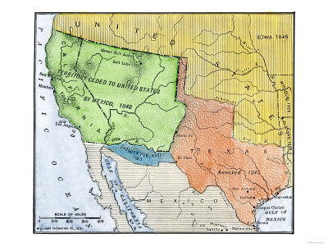
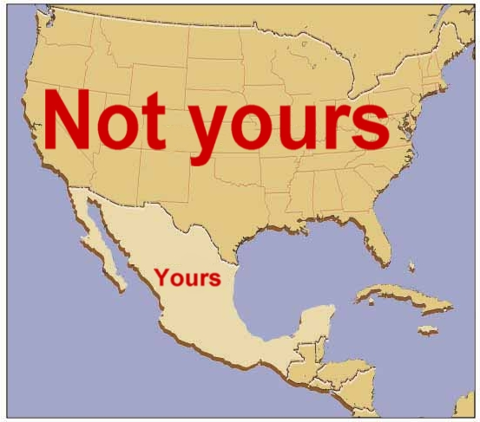
Mexican-American War 1846-48
USA greedy again, wanting more land! Remember War of 1812??????
By winning this war, we got California + 6 other states

Slide 12
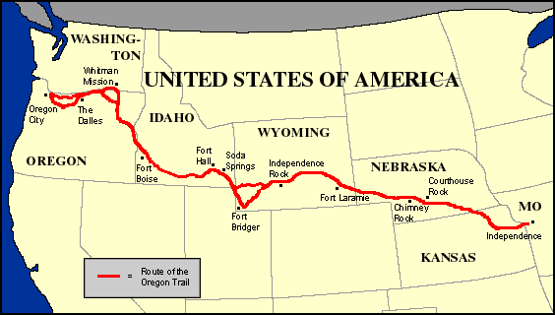
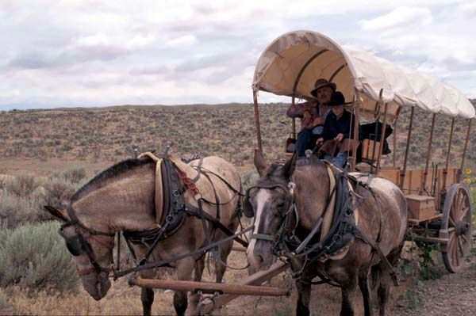
Oregon Trail and others
At first, missionaries wanted to spread Christianity to the Natives living out west, so they moved West

Slide 13
More Western Expansion, Part 2
Recap:1790 – 4 million people, 13 states
1820 – almost 10 million people and 24 states

Slide 14
Technology Helps Westward Expansion
1. Transportation
2. Communication
3. Better Tools and Equipment

Slide 15
1. Better Transportation
Easier and quicker to move both people and stuff from place to place thanks to the following four:
Canals
Steamboats
Railroads
Trails

Slide 16
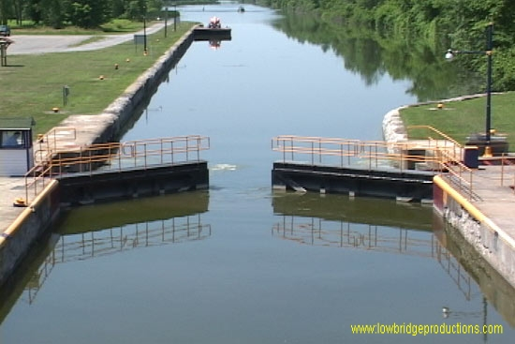
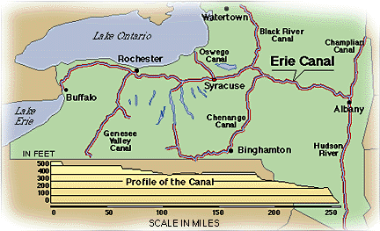
Canals – a man made river
The first canal, Erie Canal, is built connecting Hudson River with the Great Lakes (400 m)

Slide 17
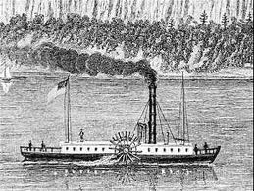
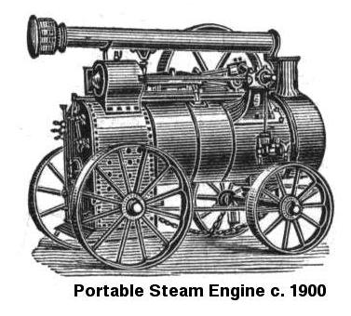
Steam Power – easier than man power
Steam power made it easier to buy and sell your goods to other towns. Flatboats were unable to go upstream.
Robert Fulton invents Steamboat in 1807

Slide 18
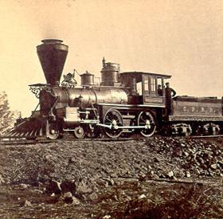
Railroads – chooo choooo. All aboard!
Now you can travel to CA in 6 days instead of 6 months

Slide 19
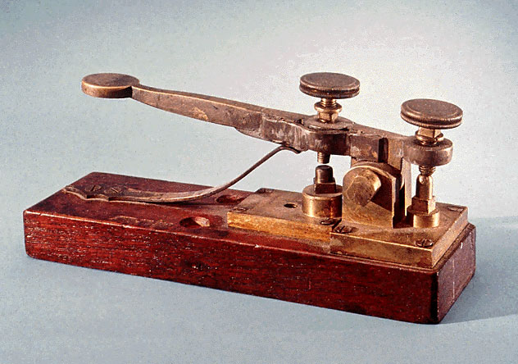
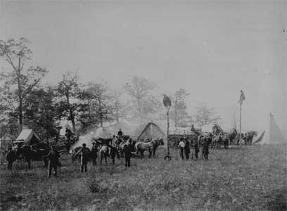
2. Faster Communication
Telegraph is first; telephone is later (1875 by Alexander Graham Bell)
Telegraph by land

Slide 20
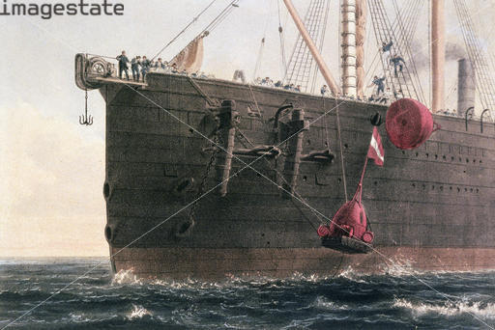
Telegraph p. 2
Wires even laid across the big Atlantic Ocean
And by water

Slide 21
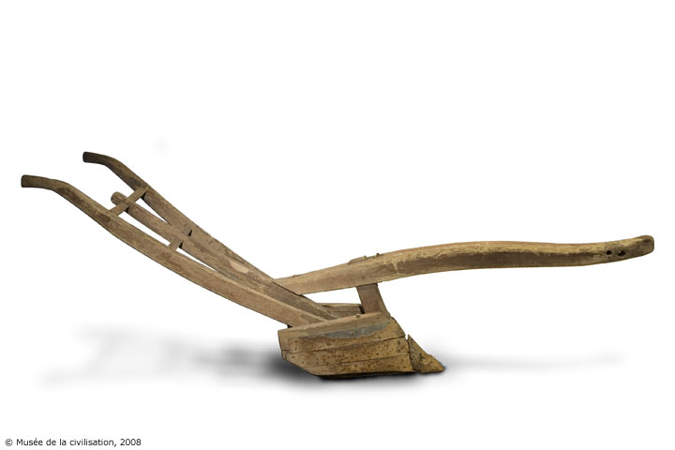
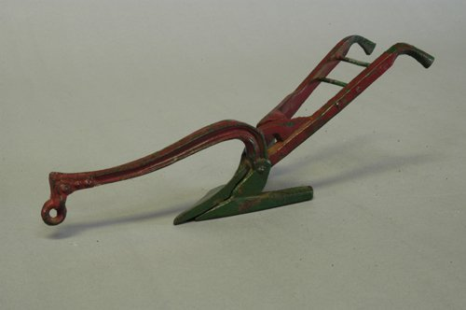
3. Better Farm Equipment
Made farming so much easier to do
Wood plow is replaced by….
….. the iron plow

Slide 22
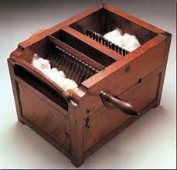
Cotton Gin discovered in 1793
1 pound of cotton a day compared to 50 pounds a day

Slide 23
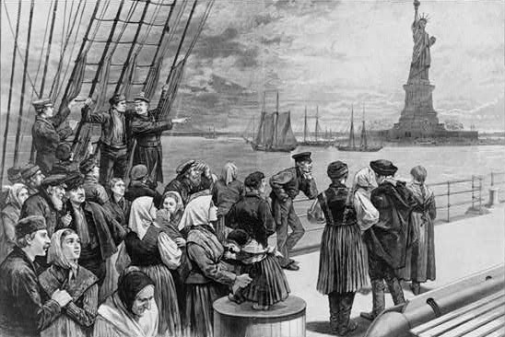
Immigration – We’re coming to America!
Free land in the west, more job opportunities, and freedom of religion

Slide 24
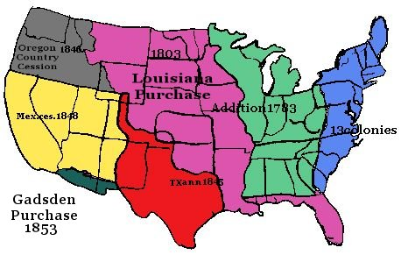
Manifest Destiny - God wants us to control the entire continent!
Look how fast we went from 13 colonies to…

Slide 25
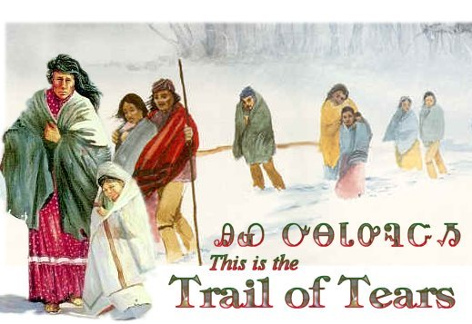
Indian Removal Act of 1830
More settlers moving in….meaning Indians forced out

Slide 26
Part 3: Important People
Lewis and Clark
Robert Fulton
Andrew Jackson
Zachary Taylor
Zebulon Pike
Levi Strauss
Benjamin Banneker
Sacajewea

Slide 27
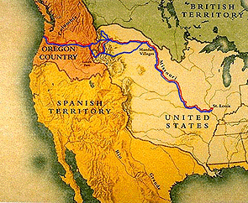
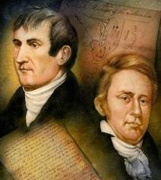
Lewis and Clark
President Jefferson asked them to go and explore the land from LA Purchase; took almost 3 years to go to the Pacific Ocean and back using mostly rivers

Slide 28
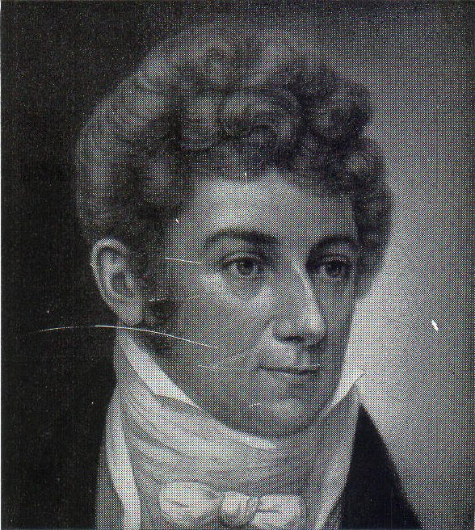
Robert Fulton
Steam power running steamboat and trains
In 1807, this boat changed America
I so smart!

Slide 29
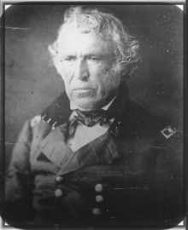
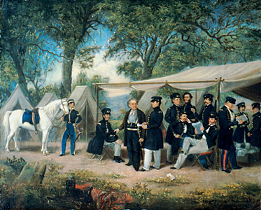
Zachary Taylor
War hero of the Mexican War 1846-48
Guess what he later became?
And they said I wasn’t a smart man! Ha ha

Slide 30
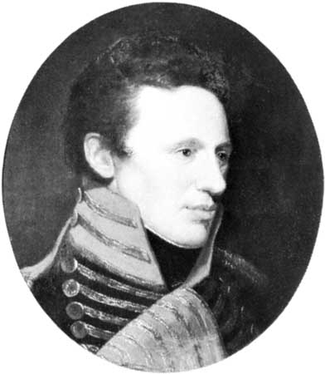
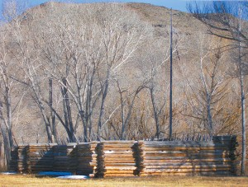
Zebulon Pike
What was he famous for?

Slide 31
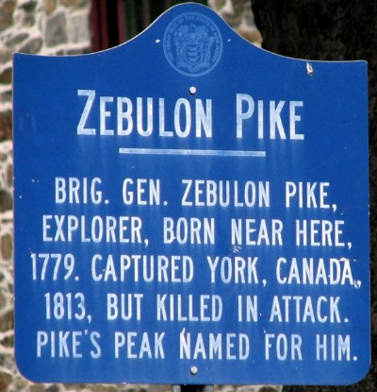
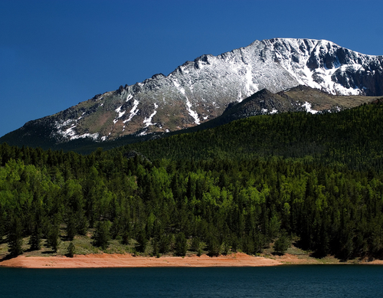
Pike’s Peak
Lt. Zebulon Pike was exploring West into Colorado

Slide 32
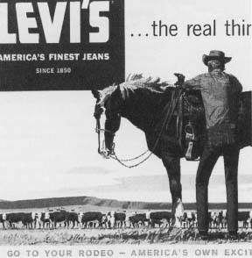
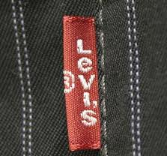
Levi Strauss
You probably wear them. The cowboys loved them.
Chicks dig this look too!

Slide 33
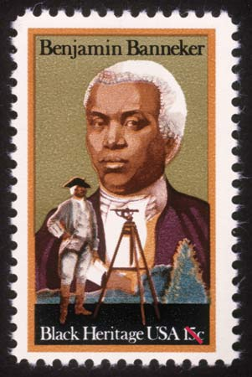
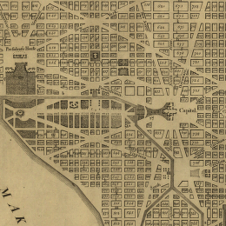
Benjamin Banneker
I helped design our nation’s capital city

Slide 34
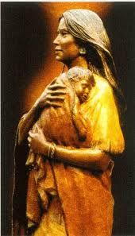
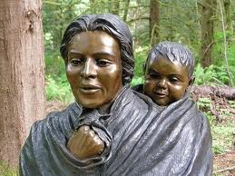
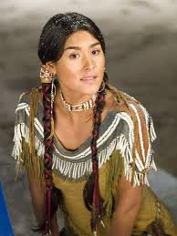
Sacajawea
This Shoshone woman was the interpreter and guide to help Lewis and Clark cross over the West to the Pacific Ocean.
There are more statutes of me in USA than any president!

Slide 35
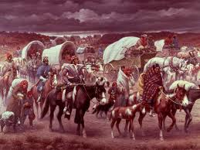
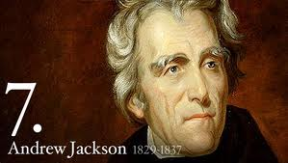
Andrew Jackson
Another great General from the War of ____ who later went on to become our _____ president.

