Slide 1
Welcome to the New Nation
I think you will enjoy this so stay awake now

Slide 2
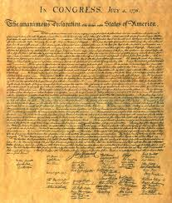
Review: Declaration of Independence
“The right to “life, liberty, and the pursuit of ?”
Who ?
When?
Why?
Where?

Slide 3
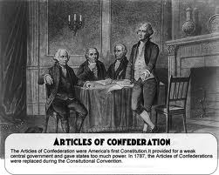
Articles of Confederation
1st American govmt plan: Submitted 1777; ratified by states in 1781 (1787)
Very weak because power was limited
Unable to create a military (army, navy, marines)
Unable to tax the people
No Congress

Slide 4
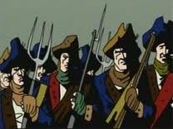
Shays’s Rebellion
Poor people were losing their homes because they couldn’t pay their taxes
Daniel Shay organized a mob of 1,000 people
Massachusetts Governor calls state army; no USA help available; state army wasn’t good enough
Change is needed – a strong NATIONAL government!

Slide 5
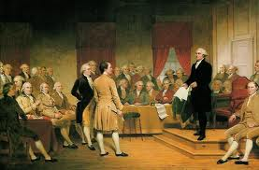
Constitutional Convention (1787)
Who will lead this group of men?
Where?
55 delegates, 12 states (RI absent)

Slide 6
Constitutional Convention p2
Major issues to discuss:
1.Rights of the states
2. Slavery
3. Role of the president
4. How to determine representation?

Slide 7
Rights of the States
Will states be able to make laws for their states?
Or will all laws come from the NATIONAL government?
Can you have both National Laws and State Laws?
Who will be the more important government – states or nation?

Slide 8
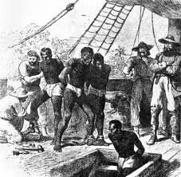
Slavery
Can states choose to have or not?
Decided: 1808, no more buying from Africa
3/5 rule

Slide 9
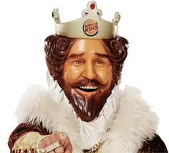
Role of the President
Do we want another King?
How long in office? Lifetime?

Slide 10
How to do determine “Representation”
If the representatives make the laws, how many representatives will come from each state?
Big states want more representatives
Small states want it to be equal. (“Just because you have more people doesn’t make you better than me.”)

Slide 11
3 Plans were presented
1. Virginia Plan – Congress would be two houses. # of representatives determined on state’s population. What states are happy with this plan?
2.New Jersey Plan – one house; equally represented. What states are happy with this plan?
3. Connecticut Plan …..

Slide 12
The “Great Compromise”
The Great Compromise is the Connecticut Plan!
Made both the big and the small states happy. How? (Hint: # of houses)
Either house could present a bill for a new law
Both houses had to pass the bill

Slide 13
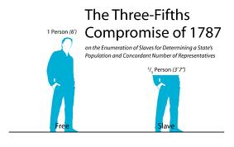
Representation
Held: One representative for every 30,000 people.
Are Black people, people? Do they count the same as White people?
Held: Nope
5 slaves made 3 people, not 5

Slide 14
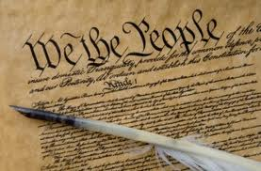
US Constitution
Three Branches of Government. Can you name them?
Separation of powers preferred instead of one person being all that

Slide 15
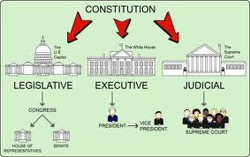
Three Branches of Government
Legislative
Executive
Judicial

Slide 16
Three Branches Photo

Slide 17
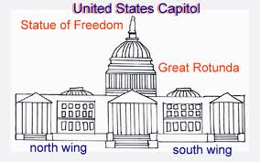
Legislative (Congress)
Makes the law – start out as bills; become laws when passed
Two houses

Slide 18
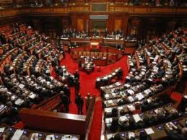
Legislative House #1
US Senate, must be 30 yrs old
2 per state (100 today), not based on population; 6 yr terms

Slide 19
Legislative House #2
US House of Representatives, must be 25 yrs old
Based on state population; bigger states have more reps; (435 today; GA 13); 2 year terms

Slide 20
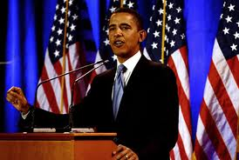
Executive
The President – 4 year term; 2 terms limit; must be born in USA and 35 years or older
Enforces the law

Slide 21
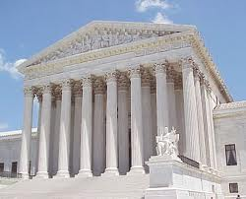
Judicial
Supreme Court (all Federal Courts); no terms (lifetime)
Interprets the law to make sure fair

Slide 22
The Nation’s Capital
Has been in three cities. ???

Slide 23
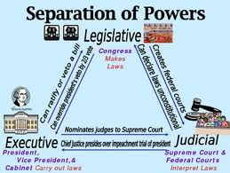
Checks and Balances

Slide 24
Federalism
The national and State Governments will SHARE the power. (Article 4 of Constitution) States decide some issues only (education, marriage); Nation decides some issues only (war). Some issues both can decide (taxes).

Slide 25
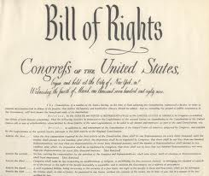
Bill of Rights
Before some states approved the Constitution, they demanded protection for people’s rights not in the Constitution

Slide 26
Functions of Government
PROTECT all Americans!
Makes the laws
Enforces the laws
Makes sure laws are fair
Provide for defense of our nation
Raising and spending $$ wisely

Slide 27
Democracy and Republic
Democracy: A form of government in which the people rule and are free to make choices
Republic: A form of government in which people elect representatives to run the government

Slide 28
Popular Sovereignty
Government is created by and for the people
not for some King or some person
The people vote to elect the men and women to make decisions in government.
Thus, it is the people who have the power

Slide 29
Key People
James Madison
Ben Franklin
George Washington

Slide 30
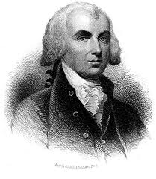
James Madison
Primary writer of the US Constitution (Father of the Constitution)
4th President (shortest too)

Slide 31
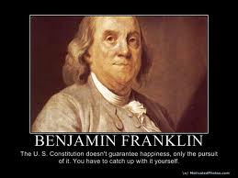
Ben Franklin
Wise old man who everyone listened to
Inventor, Poor Richard Almanac
Helped get aid from France; Treaty of Paris

Slide 32
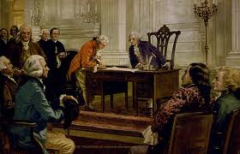
George Washington
President of the Constitutional Convention
Led American Revolution
1st President

Slide 33
Hope you enjoyed this
Tell your class , “I miss making them brownies!”

