Slide 1
Timeline showing Key Battles of the Rev War
By Paul Curcione

Slide 2
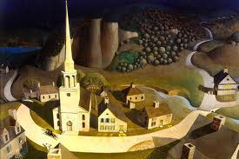
Lexington and Concord, 1775
This is where it all began?
“The shot heard around the world!”
Who got famous here? _______

Slide 3
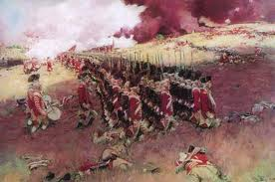
Battle of Bunker Hill, 1775
The Colonists may have lost the hill, but they gained something important. What was it? __________
What city was this battle located in? __
GB – had more men killed than colonists

Slide 4
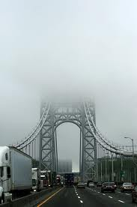
New York City, 1776
George thought he could “go toe to toe” with the greatest Army and Navy of the time. NOTTTTTTTTT!
Did God save GW? Or was it just Mother Nature?
GW was trapped so he ran, ran, and ran
GB had over 30,000 men; GW had half that

Slide 5
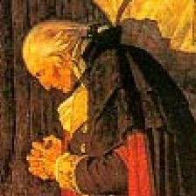
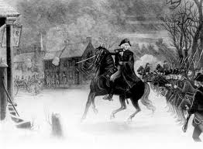
Trenton, Dec 25, 1776
GW surprises British and German soldiers by crossing what river in the middle of the night? (D--- )
No one was killed in battle, but one future pres was wounded . Who?(JM)
Did it help that this was Christmas night? ___

Slide 6
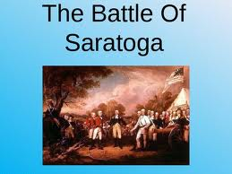
Battle at Saratoga, NY, Oct, 1777
This battle has been called the “turning point” of the war?
Why? (Hint: another country entered the war to help the colonists. Who?)

Slide 7
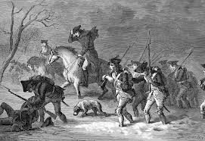
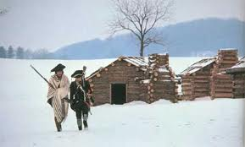
Valley Forge, PA. (Winter 1777)
GW’s troops are tired and discouraged. Many don’t even have shoes. They decide to rest up for the winter. Enter Baron Von Steuben to coach them up (about 6,000).

Slide 8
Battle of Kettle Creek, GA, 1779
600 Loyalists gathered to kick some Rebel butt. Notttttt!
Loyalists lose battle and from now on, GB can’t expect to get Loyalists to help them fight the war for them.
Wilkes County, GA

Slide 9
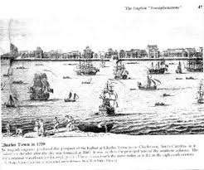
Charleston, SC; May of 1780
This was the Colonists worst defeat of the entire war. 4,600+ captured; 100 dead
Gen. Nathaniel Greene now put in charge in South.
Guerilla warfare now the way to fight GB in the South.
Guerilla warfare = hide, hit, and run.

Slide 10
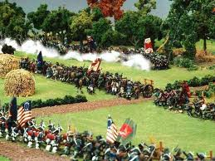
Cowpens, SC and Guilford Court House, NC in early 1781
Lord Cornwallis was now in charge of GB in the South.
Colonists using guerilla tactics to kick some GB butt both times here.
Get ready for……

Slide 11
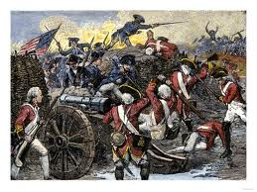
Battle of Yorktown, VA. Sept of 1781
Gen Cornwallis surrounded, and no Gen Clinton to rescue him (in NY). GW tricked Gen. Clinton.
Cornwallis surrenders 6,000 troops and this battle pretty much ends the war.
French army and navy were very _________

Slide 12
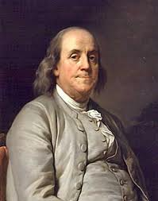
Treaty of Paris, Sept of 1783
Ben Franklin, John Adams, and a few more men work out an agreement with GB to end the war.
Bye bye GB; hello ________ (see next slide for answer)

Slide 13
USA, USA, USA!!!!!!
Time to start our new country and be the first country EVER to elect our r_______
Who gets credit for the design of this flag? Betsy ______

