Slide 1
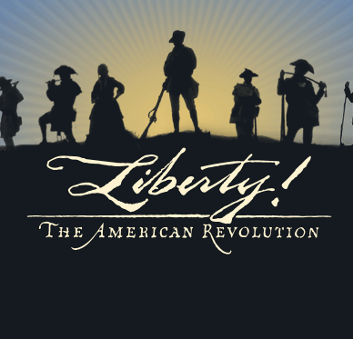
The Road to the American Revolution

Slide 2
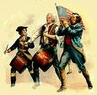

Key Vocabulary
Spain – Spanish
France – French
Britain – British
England – English
Ohio Valley
Appalachian Mountains
George Washington
colonists
Parliament
proclamation
Sugar Act
taxation
representation
Stamp Act
congress

Slide 3
Fighting for control
Vocabulary: alliance, delegate, Parliament, proclamation, budget
Both Britain and France claimed the area of the Ohio Valley. This caused conflict between France and the British. The British wanted this area for trade and growth. For France this area of land would connect New France and Louisiana.

Slide 4
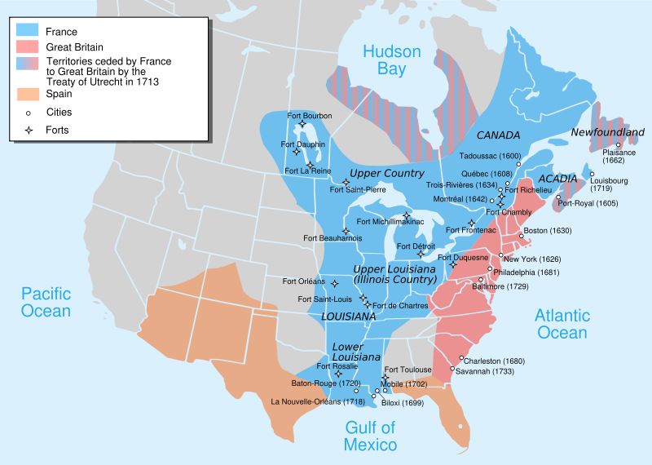
Claims to Ohio Valley

Slide 5
Fighting for Control
1750: The French sent soldiers to the Ohio Valley to force out the British. The French also built forts.
The British decided to fight back.
In 1754: The French and Indian war began in North America. This war would later spread to Europe.
The Indians fought for both sides but mainly they fought for the French.

Slide 6
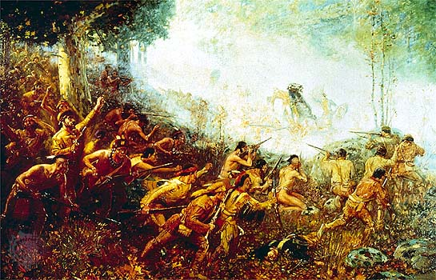

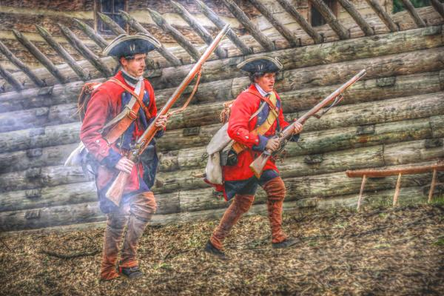

Slide 7
Fighting for Control
1754: Colonial leaders met in Albany, New York. 7 colonies sent delegates, or representatives including Benjamin Franklin.
July, 1754: Virginians built Fort Necessity and had their first battle with the French and Indians. The French and Indian won that battle.

Slide 8
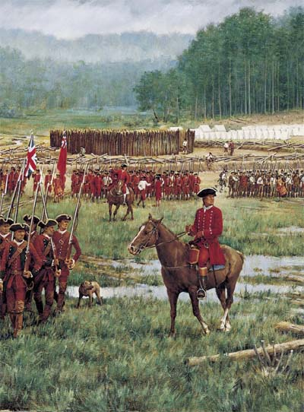
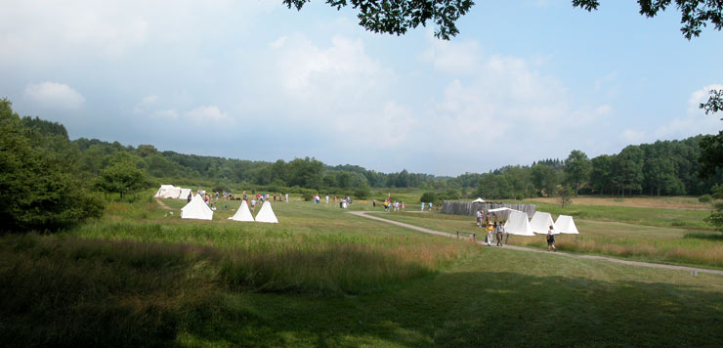
Fort Necessity

Slide 9
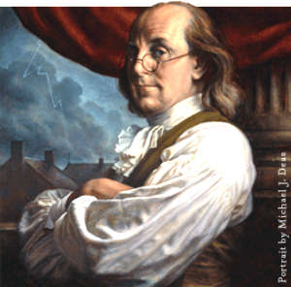
Benjamin Franklin
Benjamin Franklin wanted the colonies to unite and fight the French. However, the colonies were not ready to unite and fight as one country.

Slide 10
Colonists Need Help
The colonist needed help to win the war between the French and Indian and went to the Parliament (the lawmaking branch of the British government). The Parliament sent an army to help the colonist.
The early battles did not go well for the British. The more troops and supplies that the British sent allowed the war to slowly change in the favor of the colonists.
The French and Indian war ended in 1763 with the Treaty of Paris. The Treaty of Paris gave Britain most of Canada, all French lands east of the Mississippi River and Spanish Florida. France lost nearly all of its land in North America.

Slide 11
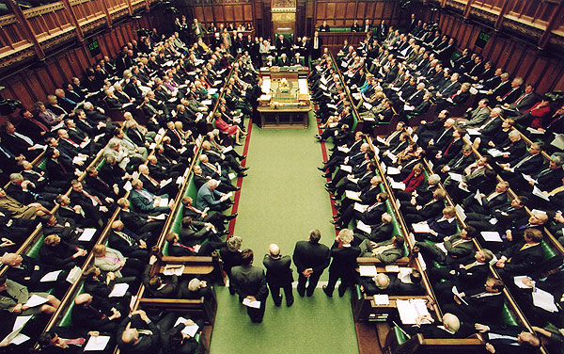
British Parliment

Slide 12

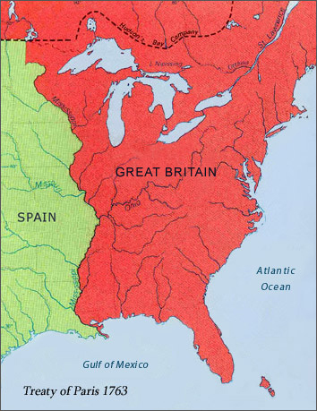
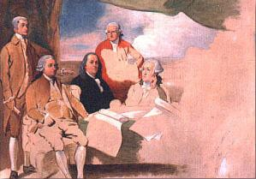
Treaty of Paris

Slide 13
Troubles Continue
Since the lands between the Appalachian Mountains and the Mississippi River now belonged to the British colonists wanted to settle on this land.
However, many Native Americans already lived on these lands and were very determined to keep them.
1763: An Ottawa chief united many of the Native American groups along the Mississippi River. These Native Americans captured some of the British forts and attacked many of the colonists’ settlements around the forts.
King George III wanted to end the fighting between the Native Americans and the colonists. He made the Proclamation of 1763 which stated that the lands west of the Appalachian Mountains belonged to the Native Americans and white settlers had to move.
The colonists ignored the king’s proclamation and the fighting continued between the Native Americans and the colonists.

Slide 14
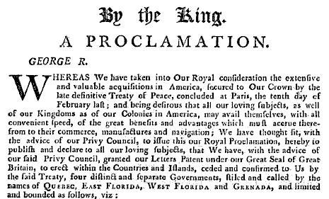
Proclamation of 1763
In order for Britain to pay for the French and Indian war taxes were passed by the Parliament. Britain thought that the colonists should help in paying as well so Parliament began passing taxes to raise money for Britain.
1764, Parliament passed the Sugar Act. The Sugar Act taxed sugar and molasses brought to the colonies from the West Indies. This act hurt the shipping business in New England.

Slide 15
Colonists Speak Out
Vocabulary: representation, treason, congress, boycott, repeal, imperial policy, protest
1765: Parliament passed another tax law. This new tax was called the Stamp Act. The Stamp Act placed a tax on many paper items like newspapers, legal documents, and even playing cards.
Parliament and British leaders thought that the tax was fair however, colonists were angry because colonists were not represented in Parliament and did not have any say in these new laws.
October, 1765: Representatives from 9 colonies met in New York City in what became known as the Stamp Act Congress. During this meeting with representatives colonial leaders spoke out against the Stamp Act. People began to use the words “No taxation without Representation.”
Many colonists wrote letters to Parliament about their disapproval of the Stamp Act. Other colonists decided to boycott and refuse to buy all British goods. Some colonists chose simply not to buy any taxed goods.
1766: Benjamin Franklin travels to London to speak out against Britain’s tax laws.
In 1766: Parliament decided to repeal or take back the act. However the very next day Parliament passed the Declaratory Act. This new Act stated that Parliament had full power to make laws for the people of America.

Slide 16
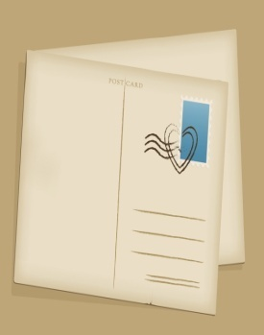
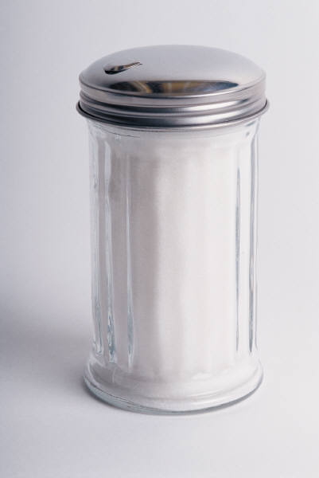
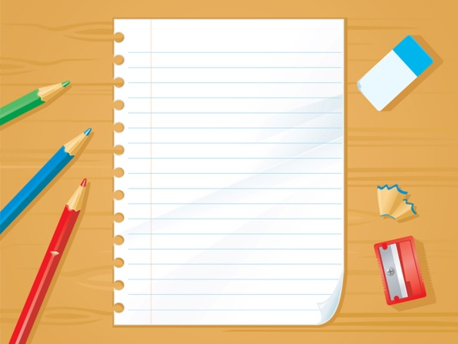
Causes that lead to the American Revolution
French and Indian War
Proclamation 1763
Sugar Act
Stamp Act- “No taxation without Representation.”
Townshend Act
Quartering Act
Boston Massacre
Boston Tea Party
Intolerable Acts

Slide 17
Townshend Acts
1767: Parliament passed new tax laws called the Townshend Act.
Under the Townshend Act imports such as tea, paint, glass, and paper were now items that were taxed. With these new laws a new group of tax collectors was set up.
Colonists joined together and boycotted British goods. Boston decided they would not import taxed goods.
Sales of British good went down, which meant that tax collectors collected little money.
Again in 1770 Parliament decided to repeal the Townshend Acts EXECPT for the tax on tea.
More and more colonists joined in the protest and Parliament decided in 1770 to send 9,000 British soldiers to the colonies.

Slide 18
The Sons and Daughters of Liberty
Shortly after the Stamp Act was passes a group of colonists called the Sons of Liberty began to work against it.
The Sons of Liberty captured British workers trying to collect the tax and dumped tar and feathers on them. They also chased any tax collectors out of their towns.
The Daughters of Liberty decided to spin their own thread and wove their own cloth instead of buying British cloth. The cloth these ladies wove became very popular.

Slide 19
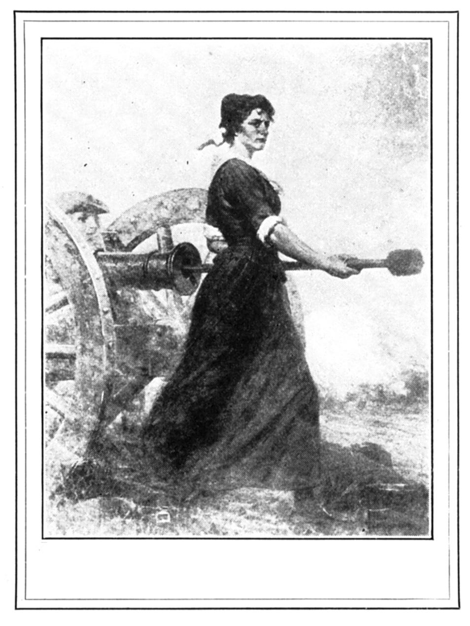
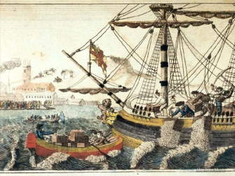
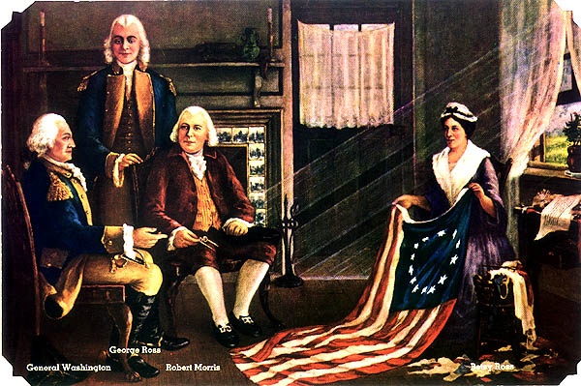
The Sons and Daughters of Liberty

Slide 20
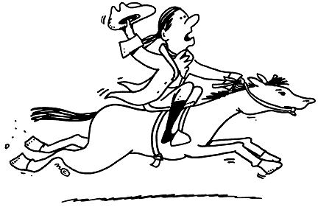
Committees of Correspondence
The colonists realized that they could work together since the Stamp Act was repealed. However, the colonists also realized that news traveled slowly and it would take many days for people to find out about important events since letters were delivered by riders on horseback.
The colonists decided to form Committees of Correspondence. Members in these committees wrote letters to one another about the events that were happening in their towns and colony.

Slide 21

Samuel adams
1764: Samuel Adams was the first to organize a committee of correspondence in Boston. Samuel Adams spoke out against the British laws and orders that the king and Parliament issued.
The following year New York formed another committee. In 1773 Virginia formed a committee. Soon colonists wanted a committee in every colony. The committee members asked people to protest and work against British policies.

Slide 22
The Boston Massacre
Colonists were angry having British soldiers in their towns. Many colonists made fun of the British soldiers’ uniforms. The soldiers were called “lobsters” or “red coats”. British soldiers were angered by this treatment. The anger between the British Soldiers and the colonists caused fights to break out.
March 5, 1770 the worst fight broke out between the colonists and the British soldiers. The colonists were throwing snowballs with rocks inside at the British soldiers. As the crowed moved forwards a few soldiers were knocked down. The soldiers opened fire immediately. 5 colonists were shot 3 were killed on the spot and 2 later died.

Slide 23
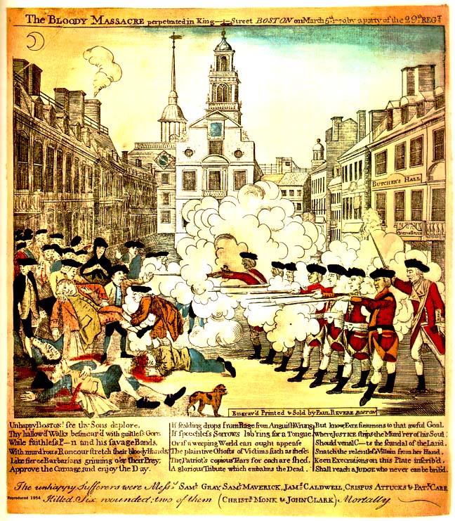
The Boston Massacre

Slide 24
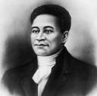
Crispus Attucks
Among the dead was Crispus Attucks. He was an African American sailor and was known as the first person killed in the fight for the colonies’ freedom.

Slide 25
Boston Tea Party
1773 Parliament passes the Tea Act.
The Tea Act would force the colonists to but their tea from the East India Company since the East India Company had a monopoly on tea.
The colonists had 2 choices. 1 choice was to pay the tax on tea. The 2nd choice was not to drink tea at all.
Many colonists chose to boycott and not buy the tea. Some colonists made their own tea.
November of 1773, 3 ships with thousands of pounds of tea reached Boston.
December 16, 1773: 150 members of the Sons of Liberty dressed as members of the Mohawk tribe and marched down to Boston Harbor.
The Sons of Liberty then marched on the ships, broke open more than 300 chests of tea and threw it overboard into the harbor.
This became known as the Boston Tea Party. Many people believed that Samuel Adams planned this event

Slide 26
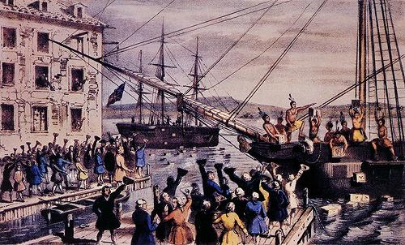
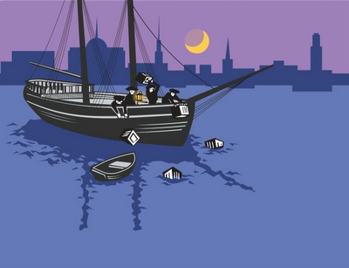
Boston Tea Party

Slide 27
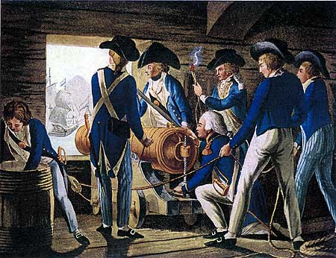
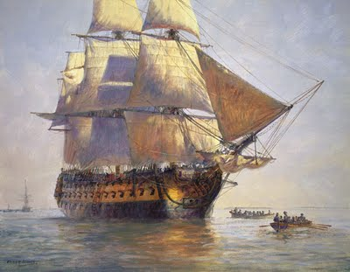
Intolerable Acts
Parliament called these Coercive Acts.
Parliament passed these laws to punish the Massachusetts colonists for the events of the Boston Tea Party.
The British Navy was ordered to blockade Boston Harbor preventing any ships from entering or leaving the harbor.
Britain stopped the Massachusetts legislature from meeting.
The Massachusetts colony was place under the control of British General Thomas Gage.
The colonists were also ordered to quarter British troops.
The colonists called these Intolerable Acts. These laws united the colonists against the British.

Slide 28


Quartering Act of 1765
Britain ordered the colonists to quarter British soldiers. This order forced the colonists to give food, housing, and supplies to the king’s solders who were sent to control the colonists and collect taxes.

Slide 29
Let’s Review!
What are the 8 causes to the American revolution?
What did Samuel Adams do?
Who is Crispus Attucks?
How do you think the colonists feel after everything that has happened so far?
What do you think will happen next?

Slide 30
Important People
Samuel Adams – Started the Sons of Liberty and Committees of Correspondence; leader of the Boston Tea Party
Crispus Attucks – African American who was killed at the Boston Massacre
King George III – King of England during the Revolutionary War
Lord North – British prime minister who punished Boston after the Boston Tea Party by closing the port of Boston and sending more soldiers (Intolerable Acts)
Thomas Paine – wrote Common Sense, a pamphlet selling over 100,000 copies, saying it was common sense for the colonists to break away from England.

Slide 31
The beginning
In September 1774: Colonial leaders met in Philadelphia. Many colonists were afraid that Britain would take stronger action against them after the Intolerable acts. The meeting that took place in Philadelphia was the first of its kind and was later named the First Continental Congress.

Slide 32
The First Continental Congress
This congress sent a signed petition which is a signed request to the king. This petition reminded the king of the colonists’ basic rights as British citizens at one time. The petition also stated that the colonists had a: right to life and liberty, the right to assemble (gather together), and the right to a trial by jury.
May 10, 1775 was the deadline for Parliament to answer the petition from the colonists.
At this meeting congress also voted to stop most trade with Britain. The colonies were also asked to form militias (armies) of citizens as well.

Slide 33
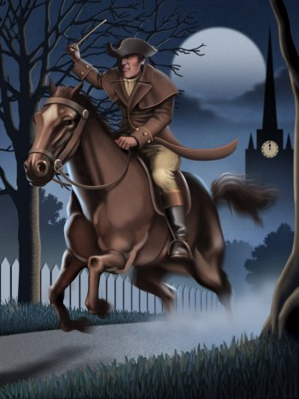
Paul Revere
The British wanted to march into Lexington secretly, but Paul Revere another member of the Sons of Liberty found out about the plan and rode ahead to warn Samuel Adams and John Hancock that the British were coming. When the British finally arrived the Minutemen were armed and waiting for them.

Slide 34
Lexington and Concord
The Massachusetts colonist quickly formed militia units called the Minutemen. They were called this because they were ready to fight at a minutes notice.
April 1775: General Gage of the Britain Army heard that Samuel Adams and John Hancock were meeting in Lexington. General Gage also heard that the Minutemen had weapons in Concord. General Gage sent 700 British soldiers to Lexington and Concord to arrest the two leaders of the Sons of Liberty and to take the weapons.
The leader of the Minutemen was John Parker.
It is not known which side fired first but when it was over 8 Minutemen were killed and several were wounded. The British marched on to Concord to find the weapons that were being stored. However they were to late the colonists had already moved the weapons.
Lexington and Concord are known to be the first battle in the American Revolution.
By the time the British returned back to Boston 73 soldiers were killed and 174 were wounded. Less than 100 colonists had been killed or wounded.
The first shot fired at Lexington was later known as “the shot heard around the world.”

Slide 35
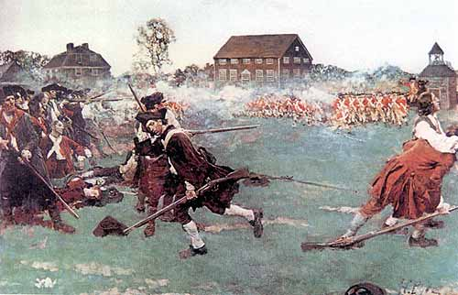
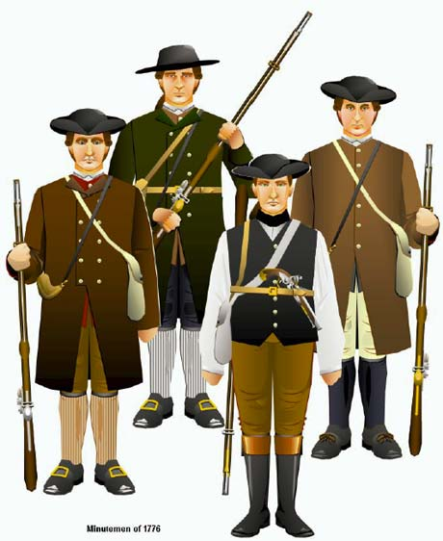
Lexington & Concord, Minutemen

Slide 36
The Second Continental Congress
News about Lexington and Concord spread through the colonies quickly. Colonial leaders called for the Second Continental Congress to meet in Philadelphia May 10, 1775.
The delegates at this meeting were divided. Some wanted to go to war with the British. Others wanted to avoid war like John Dickson of Pennsylvania. By June 1775 congress agreed that the colonies should prepare for war.
Congress formed an army called the Continental Army. The Continental Army was made up of full time soldiers. This differed from the militias that were previously set up because they were part time ordinary citizens.

Slide 37
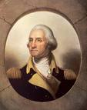
Commander and Chief
George Washington was chosen to be the Commander in Chief, which would be the leader of all military forces.
In order for the Continental Army to have supplies, each colony was asked to give money to pay for guns, food, uniforms, and to pay for the soldier’s service.
Congress printed its own money known as the Continental currency.

Slide 38
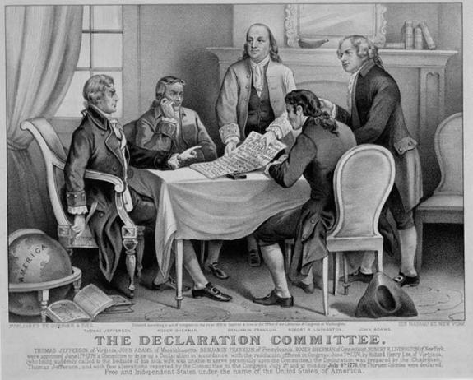
2nd Continental Congress

Slide 39
The Battle of Bunker Hill
Took place on June 17, 1775.
Preparation for the battle took place on June 16. The soldiers were told to build earthworks which are walls made of stone and earth to help defend themselves during battle.
General Gage of the British sent 2,400 British soldiers to capture Breed’s Hill when he heard what the colonists were up to.
The British were forced back towards the river twice. However, colonists ran out of bullets and were forced to retreat.
The nearby city of Charleston had been badly damaged. It was set on fire by the cannons shooting from the British ships in the Harbor.
The British captured Breed’s Hill. The battle was later named wrongly and called the Battle of Bunker Hill.
The British may have won the battle but suffered heavy losses. More than 1,000 British soldiers had been killed or wounded. Only 350 colonists had been killed or wounded.

Slide 40
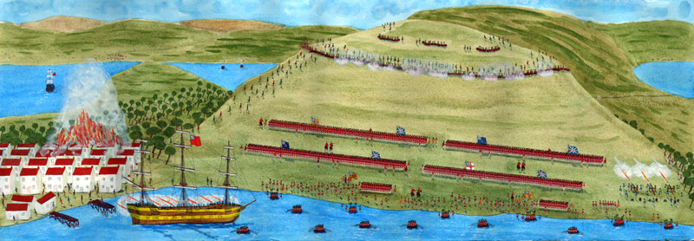
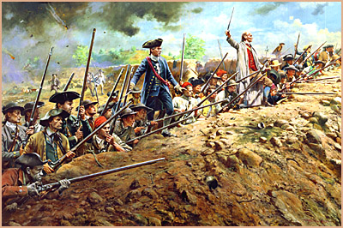
The Battle of Bunker Hill

Slide 41

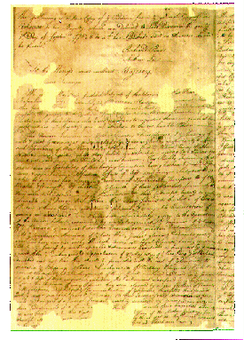
The Olive Branch Petition
July 5, 1775, Congress sent another petition to King George III. The petition became known as the olive branch since it asked for peace.
By the time the petition reached London the Battle at Bunker Hill angered the British leaders including the king so much that he promised to do whatever necessary to crush the colonists’ rebellion

Slide 42
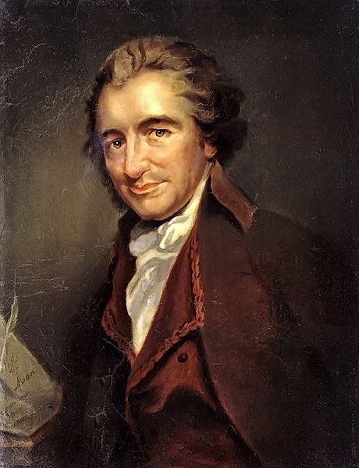
Declaring Independence
Many colonists believed that their problems with Britain could not be settled. Thomas Paine wrote Common Sense, a pamphlet selling over 100,000 copies saying it was common sense for the colonists to break away from England. Paine wrote that he believed the colonists should rule themselves.
Many colonists talked about Thomas Paine’s idea and they began to call for independence. Independence was the freedom to govern themselves.

Slide 43
The Road to freedom
The Second Continental Congress also began to discuss independence. John Adams argued for it. John Adams believed that independence was the only way the colonists would truly have liberty. Richard Henry Lee told the congress that the colonists no longer had owed their loyalty to the king. Richard Henry Lee called for the congress to make a resolution, which is a statement of independence. Part of Lee’s resolution stated “That theses united colonies are, and of right ought to be, free and independent states.”

Slide 44
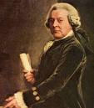

John Adams Richard Henry Lee

Slide 45
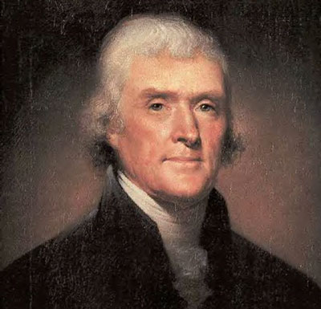
Thomas Jefferson
Congress chose a committee to write the Declaration of Independence that would be sent to the king.
Thomas Jefferson wrote the first draft. For 17 days every evening he wrote and rewrote the draft for the Declaration of Independence. Other members of the committee gave ideas but Jefferson was the main author.

Slide 46
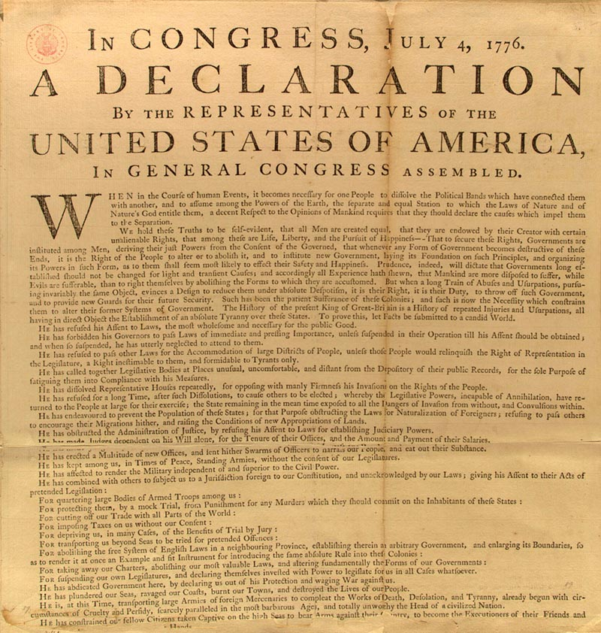
Declaration of Independence

Slide 47
Declaration of Independence
Parts to the Declaration of Independence
Preamble- is the first part of the declaration. In this part Jefferson told why the declaration was needed, why the colonies had the right to break away from Britain and form a new nation.
Second part describes the colonists’ main ideas about government and that all people have certain rights that governments cannot take away. Jefferson included that people have the right to live, be free, and seek their own happiness. The famous words from this section are: “We hold these truths to be self-evident, that all men are created equal, that they are endowed (provided) by their Creator with certain unalienable Rights, that among these are Life, Liberty, and the Pursuit of Happiness.”
The longest part of the declaration lists the colonists’ grievances. These grievances outline the complaints or charges against King George III and Parliament. This part also states that the colonists’ tried to settle their differences peacefully.
The last part stated the colonies were free and independent states.

Slide 48
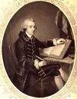
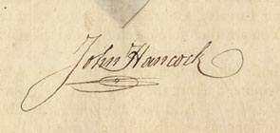
Declaration of Independence
June 28, 1776 the Declaration of Independence was read to the congress. The congress talked about it, made a few changes, and on July 2nd voted to approve the declaration and cut ties with Britain.
July 4th, 1776 congress voted to accept the final wording of the declaration and on July 8th Colonel John Nixon read the Declaration of Independence to the public for the first time.
August 2nd, the members of the Second Continental Congress signed a copy of the Declaration of Independence. John Hancock, the president of the congress was the first to sign it. He signed his name large enough so the king would not need to use his glasses to read it. The way he signed it became so famous that the term John Hancock now means “a person’s signature.”
When the Declaration of Independence was approved only white men who owned property could vote. Some people believed this to be unfair. It would take many years for women, African Americans, Native Americans, and other groups of Americans to share fully in the promise of the Declaration of Independence. But the declaration did inspire people all over the world to work for equal rights and freedom.

Slide 49
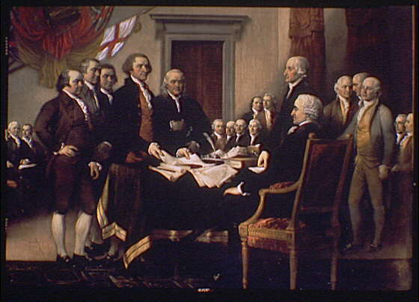
INDEPENDENCE DAY July 4, 1776

Slide 50
Important People
Benjamin Franklin – American statesman who persuaded the French to support the Americans and who helped negotiate the Treaty of Paris.
Nancy Hart – Patriot who killed two British soldiers who came to her north Georgia home
Patrick Henry – Virginia lawyer who said the colonists should not obey the Stamp Act since they were not represented in Parliament. Famous for his fiery speech, “Give me liberty or give me death!”
Thomas Jefferson – 3rd president of the United States, author of the Declaration of Independence

Slide 51
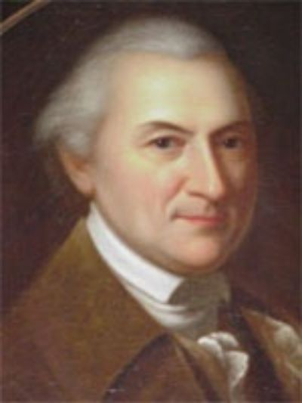
Forming a New Government
Another committee was set up by the Continental Congress to plan on how the 13 colonies should be united. John Dickinson was the head of this committee. The committee decided that each state should govern themselves, but that all of the states would work together on national issues.

Slide 52
Articles of Confederation
Articles of Confederation was the first plan of government for the United States. Each state elected representatives to serve in a national legislature. This would be called the Confederation Congress. Each state whether large or small had 1 vote. This congress helped make laws for the nation. It also helped keep the states together during the Revolutionary War.
The articles limited the powers of the national government. Laws could only be passed if representatives from at least 9 of the 13 colonies agreed. Congress did not have the power to control trade or collect taxes. Congress had the power to declare war, make treaties, and borrow money. Congress could ask for an army but the states had to provide the soldiers. Congress could ask the states for money to cover expenses, debts from war however; it could not force the states to pay.

Slide 53
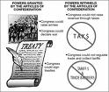
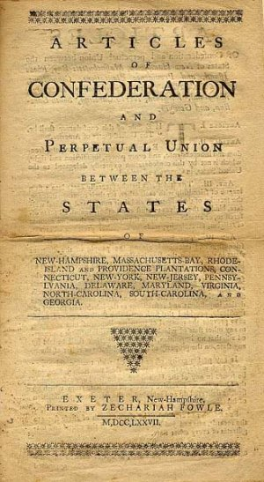
Articles of Confederation

Slide 54
Americans and The Revolution
Personal Hardships
Even though the Declaration of Independence showed that the colonial leaders had united against Britain, the colonists themselves were still divided. The colonists had to decide whether to stay loyal to the king or to support independence.

Slide 55
Which side to choose?
The colonists that remained loyal to the king were called loyalist.
The colonists that supported independence were called patriots.
About 1/3 of the colonists decided not to choose sides and stayed neutral.

Slide 56
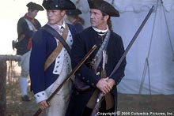
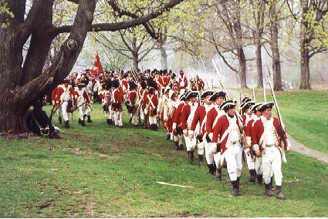
Patriots Vs. Loyalist

Slide 57
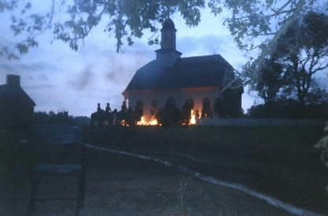
Personal Hardships
As colonists took sides friendships, church groups, and families were broken apart.
Colonists faced many difficulties: homes and towns were often robbed and destroyed by the British army.

Slide 58
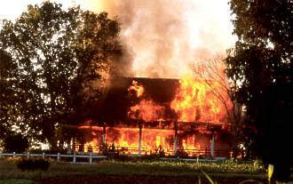
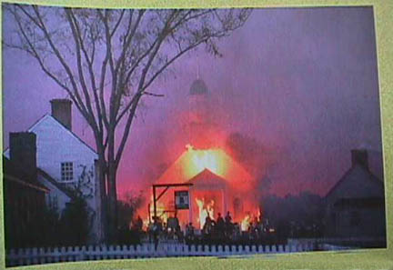
British Destroy towns and homes of the colonists

Slide 59

Economic Hardships
A major problem the colonists faced was a shortage of goods since the British set up blockades so that trading ships could not get to the American ports.
Since there was a shortage of goods Americans faced inflation.
Inflation is a rise in the price of goods and services during a shortage.

Slide 60
Economic Hardships
Another cause of inflation was the falling value of colonial currency (money) called Continentals.
Congress printed too many Continentals to pay for the war; by doing this the Continentals became less valuable.
Congress had difficulty paying for the war.

Slide 61
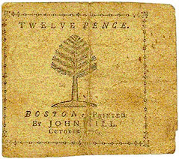
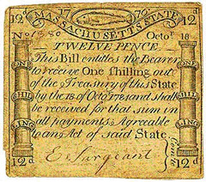
Continentals

Slide 62
MORE ECONOMIC HARDSHIPS
Due to the shortage of goods, some farmers and shopkeepers began profiteering, which was charging extra high prices for goods and crops.
States made laws to limit how much farmers could charge for food, it also made it illegal to collect and hide large amounts of goods. But these laws were usually broken.

Slide 63


Women and the War
Since men left to fight in the war, women took on new roles.
Women ran farms, businesses, raised money for the war, and collected clothing for the soldiers.
Women cooked and washed clothes in army camps. Some women brought water to soldiers during battles.

Slide 64
Women in History
Nancy Hart – Patriot who killed two British soldiers who came to her north Georgia home
Molly Pitcher – American patriot who carried pitchers of water to the soldiers and took her husband’s place firing the cannon after he was wounded
Deborah Sampson- Pretended to be a man so that she could fight during the war.

Slide 65



Nancy Hart Molly Pitcher
Deborah Sampson

Slide 66
Women Heroes
Margaret Corbin- was wounded after taking her husband’s place in battle. She became the first women veteran to become recognized in Congress.
A veteran is person who served in the military.
There were many other women who helped in someway or another during the revolutionary war: Martha Washington, Abigail Adams, Mercy Otis Warren and many more.

Slide 67




Margret Corbin Abigail Adams

Slide 68
African Americans, free and Enslaved
When the war began 1 out of every 5 colonist were from African descent.
Many free African Americans had set up communities in northern cities like Philadelphia. But most of the African Americans lived in the south enslaved.
About 5,000 enslaved African Americans fought for the Continental army during the war. Many of them were promised their freedom as a reward for their services during the war.

Slide 69

James Armistead
James Armistead was an enslaved person from Virginia; he became a spy for George Washington. The information he gathers helped the Americans win the battle at Yorktown, Virginia. When the war ended James Armistead was given his freedom.

Slide 70

African Americans, free and Enslaved
The British governor of Virginia also promised enslaved people their freedom if the fought for the British. 300 African American soldiers fought for him.
Free African Americans also had to choose whether to fight for the British or the colonists.

Slide 71
Native Americans in the revolution
Many Native Americans chose to stay neutral at the beginning of the war. Many white settlers west of the Appalachian Mountains also chose to stay neutral.
By 1777, many Native Americans were soon divided and also had to choose sides.
Many of the white settlers eventually chose to fight with the Patriots and drive the British off their lands.

Slide 72

Native Americans in the American Revolution

Slide 73
Important People
Molly Pitcher – American patriot who carried pitchers of water to the soldiers and took her husband’s place firing the cannon after he was wounded
Paul Revere – made his famous “midnight ride” from Boston to Lexington in 1775, warning people along the way that the British were coming
George Washington – leading general of the Continental army, 1st president of the United States
Lafayette – French soldier and leading general for George Washington

Slide 74
Comparing the British and Colonial Armies
Colonial Army
Had no uniforms, only everyday clothes.
Many had no guns just axes and spears.
Most had no military training.
Had about 15,000 soldiers
Washington told congress he needed 100,000 barrels of flour, 20 million pounds of meat a year to keep his army fed.
Congress could not raise enough money for everything the army needed
British Army
One of the most powerful armies during this time.
Had experienced soldiers, about 50,000 were in the colonies
British army used mercenaries which are hired soldiers; many came from a German region. They were called Hessians.
British soldiers had to wait for a long time to get supplies and replacement soldiers since they were 3,000 miles away from home.

Slide 75


Continental British

Slide 76

British Fighting Style

Slide 77


Battle of Long Island
In the spring 1776 Washington and his army were camped on Long Island New York when the British attacked. The Americans suffered great losses at the Battle of Long Island.

Slide 78
Christmas night 1776
By December 1776 many American soldiers were ready to give up.
Washington came up with a plan for a surprise attack on the Hessian mercenaries since it was rare for battles to be fought in the winter.
Christmas night 1776 Patriot troops crossed the Delaware River and marched to Trenton, New Jersey. The Americans attacked the Hessian mercenaries while they were sleeping. The attacked lasted for an hour before the Hessians surrendered. This victory gave the Americans hope.

Slide 79

Surprise Battle on Christmas

Slide 80
The British Plan to take New York
In 1777, the British army planned a new campaign, which is a series of military actions carried out for a certain goal. The British wanted to separate communication and supplies from the New England colonies and the rest of the other colonies. British soldiers were sent to Albany New York to meet with British General John Burgoyne. Together they would attack the city from the north, south, and west. But the British troops never reached Albany they were slowed down by the battles along the way. Although this plan could have worked.

Slide 81
Battle of Saratoga
September 19, 1777 Continental forces trapped General Burgoyne’s army by the town of Saratoga, New York. The British soldiers could not break through the Americans’ lines.
The Battle of Saratoga was 2 battles that took place over 3 weeks. The second battle was lead by Benedict Arnold. The British surrendered on October 17th. With the British losing the Battle of Saratoga this was considered the turning point (which is an event that causes an important change) of the war.

Slide 82

Battle of Saratoga

Slide 83

Benedict Arnold
General Benedict Arnold led a group of soldiers in a daring attack to win the Battle of Saratoga.
Later he lead British Attacks on Virginia towns.
He became known as an American traitor.
A traitor is someone who acts against their own country.

Slide 84
Fall 1777 things take a turn for the worst
Fall of 1777 the Continental army lost a battle at Brandy Wine and the British captured Philadelphia, where they spent the winter in comfort.
The Continental army spent the winter at Valley Forge, Pennsylvania so that Washington could keep an eye on the British. This was a very difficult winter for the soldiers. Congress did not have money to send for supplies. The soldiers were low on food. Their clothing was torn and burned from battle and their shoes were falling apart. New York Governor George Clinton sent barrels of salted pork for the soldiers.

Slide 85




Valley Forge

Slide 86
Valley Forge
Marquis de Lafayette traveled from France to join the Continental army. Lafayette spent his own money to buy warm clothes for the soldiers he led. The soldiers called him “the soldier’s friend.”
Things improved at Valley Forge when Friedrich Wilhelm von Steuben arrived. He taught the soldiers better ways to march and fight, and work together.

Slide 87
Benjamin Franklin Helps
While the war went on Benjamin Franklin was in France to negotiate (to try to reach an agreement among people). Franklin convinced the French to send supplies and soldiers to help the Americans beat a common enemy the British. When the news of the battle of Saratoga reached France the French agreed to help the Americans.

Slide 88

More Help for the Americans
Bernardo Galvez of Spain gave the Americans guns, food, and money since Spain declared war on Britain also. Other nations began to help the Americans too.

Slide 89
The War at Sea
Throughout the Revolutionary War, American naval forces tried to avoid a direct confrontation with the powerful British Navy. Instead, they concentrated on disrupting Great Britain's trade.
The small Continental Navy, inflicted heavy damage on British shipping. About 800 British ships were captured or destroyed. The most famous battle involved the Captain John Paul Jones, and the British warship "Serapis." The Americans captured the 44-gun "Serapis" after a bloody, bitter fight off the coast of Great Britain.

Slide 90


John Paul Jones and the Continental Navy

Slide 91
Revolutionary War Heroes
Many civilians helped the Continental Army and Navy during the war. Civilians are people that are not in the military.
Nathan Hale was a teacher but served as an American spy in New York City during the war. When the British found out what he was doing he was captured and hanged. He is remembered for these famous words: “I regret that I have but one life to lose for my country.”

Slide 92
Revolutionary War Heroes
John Paul Jones was an American Navy commander. He battled British ships that were larger than his own. He is remembered for one battle in particular. The British asked Jones to give up. He replied with these famous words: “I have not yet begun to fight.” Jones continued to fight until the British gave up.
Mary Ludwig Hays McCauley earned the name Molly pitcher. She carried pitchers of water to the soldiers and took her husband’s place firing the cannon after he was wounded.

Slide 93
The War Moves South
Once the British found out that the Americans were receiving help from France they decided to move the fighting to the South before the French could arrive.
By moving the fighting to the south the British hoped to receive help from many of the loyalists who lived there and to capture the Southern ports so that they could receive supplies from their British navy ships.

Slide 94
Battles in the South
However the British did not expect the fighting to be much more difficult and lost several battles along the frontier.
Savannah, Georgia was Britain’s first target in the South. 3,500 British soldiers landed near the town and attacked the American soldiers.
The British later took Charleston, South Carolina once again the Americans were outnumbered.
In 1781, Benedict Arnold, a former Continental Army officer became an American traitor (someone who acts against their own country). He led British attacks on Virginia towns.

Slide 95

Attack on Savannah

Slide 96

Attack on Charleston

Slide 97
Americans Fight Back
By this time the Americans lost several battles to the British, but they continued to keep fighting and decided not to give up.
Nathaniel Greene was a general who led the Continental Army in the South. He is remembered for these famous words: “We fight, get beat, rise, and fight again.”
January 1781, the Americans won a major battle at Cowpens.
March 1781, the Americans and British battled at Gilford Courthouse in North Carolina. Although the British held the field both sides were badly weakened.

Slide 98
The War Ends
Summer of 1781, British General Charles Cornwallis had set up his headquarters in Yorktown, Virginia. Yorktown was easily surrounded by the Americans and the French. Cornwallis was trapped and under attack by both land and sea. He was surrounded for weeks and finally on October 29, 1781 he finally gave up and the Americans at last had beaten the British.

Slide 99

Yorktown

Slide 100
People to know
John Adams – a patriot, helped sign the Treaty of Paris, 2nd president of the U. S.
Benedict Arnold – American traitor who decided to help the British
Cornwallis – British general who surrendered to General Washington at Yorktown
George Washington – leading general of the Continental army, 1st president of the United States

Slide 101
Treaty of Paris
In April 1782 the two sides met in Paris, France to negotiate a peace treaty.
The negotiators for the Americans were John Jay, Benjamin Franklin, and John Adams. The Americans wanted British to recognize and accept American Independence. They also wanted all British soldiers removed from American lands.
After a year of talks, the British agreed and the Treaty of Paris was signed on September 3, 1783 officially ending the war.
The Treaty of Paris named the United States of a America as a new nation, and also set the nation’s borders.

Slide 102

Treaty of Paris

Slide 103
Effects of War
New Ideas- By 1776, States had begun to write their own constitutions. Many of the states modeled their constitutions after Virginia’s.
These constitutions included: right to a trial by jury, freedom to hold elections, freedom of the press
State constitutions did not always give people the right to life and liberty the way it was outlined in the declaration of independence. Many states did not give: women the same rights as men, and many African Americans remained in slavery.

Slide 104
When will slavery end?
In 1775, Quaker’s in Philadelphia started the first abolitionist, or antislavery group.
Elizabeth Freeman from Massachusetts sued for her freedom and won. In 1783 Massachusetts abolished, or ended slavery. Many other northern states also abolished slavery.

Slide 105
Western Settlements
After the war had ended the United States did not have enough money to pay its soldiers for their service. Since the US had won land from Britain they decided to pay their soldiers with land in areas west of the Appalachian Mountains.
The United States now stretched west to the Mississippi River.

Slide 106
Northwest Territory
Americans began to settle north of the Ohio River. This area became known as the Northwest Territory. A territory is land that belongs to a nation but is not a state or represented by the national government.
1785, Congress passed a new land ordinance, or set of laws. This ordinance explained how the territory would be measured, divided, and sold.

Slide 107
Northwest Territory
The land was first divided into large squares called townships. Each large square was then divided into 36 smaller squares.
In 1787, Congress passed another ordinance called the Northwest Ordinance. This was a plan for governing the territory. This would also form new states for the land. When each region had more than 60,000 people living there it could become a state. This ordinance also promised freedom of religion and stated that all states formed from the Northwest Territory would not allow slavery.

Slide 108
Battles for Land
Native Americans in the Northwest Territory united to fight against the new settlers.
In 1790, the Native Americans won battles in Indiana and Ohio.
In 1774, the US won a major battle in Ohio.
In 1775, the Native Americans agreed to accept the Treaty of Greenville. In this treaty the Native Americans gave up most of their lands to the Americans. After the treaty was signed many Native Americans stopped trusting the US government.
Many Native Americans sold their lands to land companies.
As time passed, more and more settlers moved farther west, cleared lands for farms and towns. The lives of the Native Americans would never be the same.

Slide 109
Sum it All up?
What were the causes of the American Revolution?
Who won?
Name some heroes of the American Revolution.
What countries were involved in the war?
What were some personal and economic hardships that were faced?
What were some important people in the American Revolution?
What was the turning point in the war?
What were the differences between the Continental and British armies?
What was the last major battle?

