Slide 1
Key People of the Revolutionary War
By Paul Curcione
Let’s see how many you can remember

Slide 2
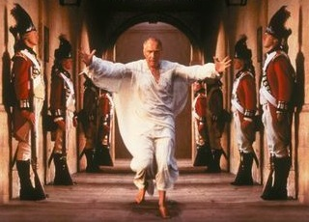
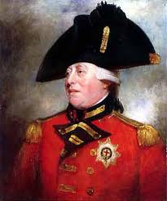
King George III
King of Great Britain from 1760 to 1820.
Won a war; lost a war ??
He was mentally unstable -disease called porphyria
Do I look crazy to you?

Slide 3
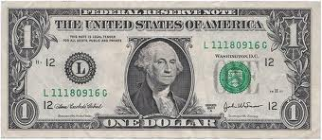
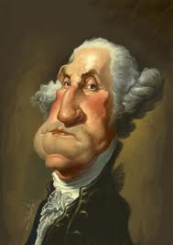
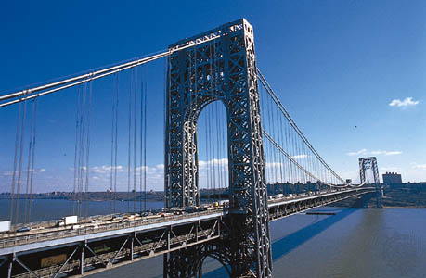
George Washington (GW)
Fought (for the British) in the French and Indian War
Commander in Chief of the American forces in the Revolutionary War.

Slide 4
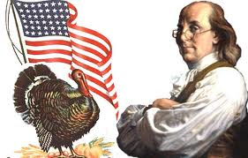
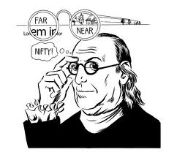
Ben Franklin, p. 1
Member of 1st and 2nd Continental Congress
USA Representative in France during the war
Inventor, Almanac

Slide 5
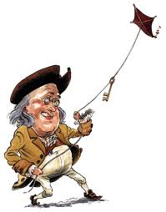
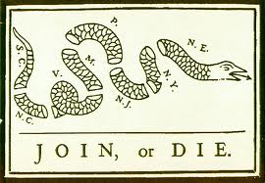
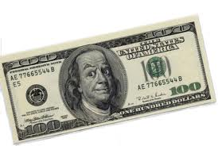
Ben Franklin, p. 2
I designed this during F & I War, not Rev War

Slide 6
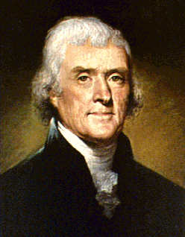
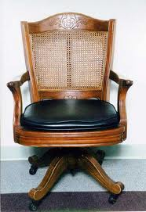
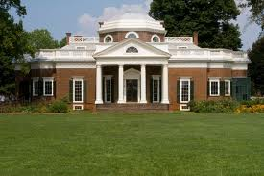
Thomas Jefferson (TJ)
Member of 1st and 2nd CC
Wrote what document?
Ambassador to France
Monticello
I am wayyyy cool!
I invented this

Slide 7
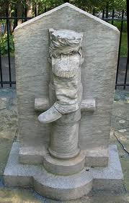
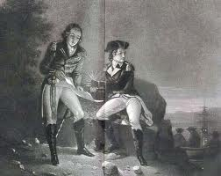
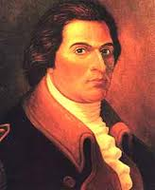
Benedict Arnold, p. 1
Brilliant USA Colonel before he became a traitor
Helped win Battle of Saratoga
Arnold and Andre plotting

Slide 8
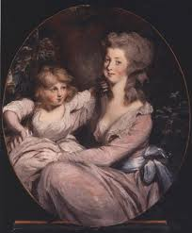
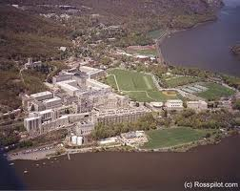
Benedict Arnold, p. 2
This is what he wanted to give up to GB
West Point – by Hudson River
Wife Peggy, a Loyalist, and daughter

Slide 9
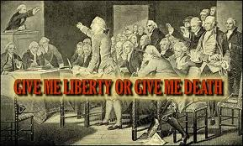
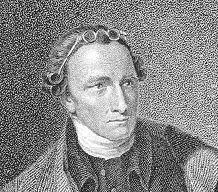
Patrick Henry
1st Governor of Virginia
Great orator (speaker); spoke out against Stamp Act

Slide 10
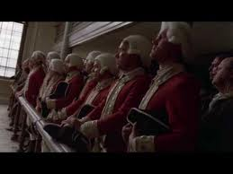
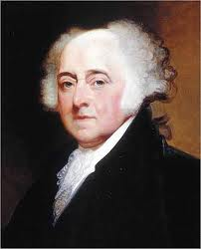
John Adams
Member of 1st and 2nd Continental Congress
Ambassador to Netherlands during the war
On Committee in charge of writing D of I
GB soldiers after the Boston _____

Slide 11
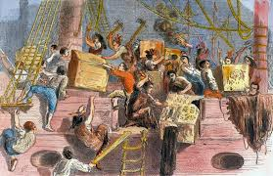
Sam Adams
Great organizer – Committee of Correspondence and the Sons of Liberty (Boston Tea Party)

Slide 12
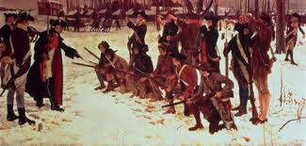
Baron Von Steuben
German officer who trained up GW’s troops at Valley Forge, PA during the 1777-78 winter break

Slide 13
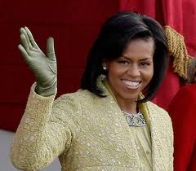
So, how many do you remember?
I love Mr. C.’s class!

